Slide 1
INTERNAL COMBUSTION ENGINES
JAY DUDHELA
Roll Num. - T13EC017
Enr. Num.- 13067011017

Slide 2
INTRODUCTION
Heat engines may be classified based on where the combustion of fuel takes place.
1. External Combustion Engines
2. Internal Combustion Engines

Slide 3
Type of Fuels
petrol engine
Diesel engine
Gas engine
Bi-fuel engine

Slide 4
Nature of Thermodynamic cycle
Otto cycle engine
Diesel cycle engine
Dual cycle engine

Slide 5
Number of Strokes per cucle
Four Stroke engine
Two Stroke engine

Slide 6
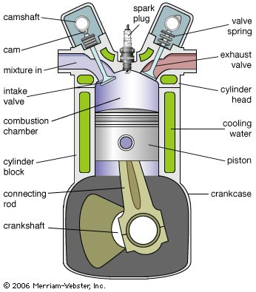
Engine details
1. Cylinder

Slide 7
Cross section showing one cylinder of a four-stroke internal-combustion engine.
In the first stroke (shown), a cam (left) compresses a valve spring, opening the intake valve to admit the fuel-air mixture to the cylinder.
Ignited by the spark plug, the burning mixture forces the piston down, producing power to turn the crankshaft and run the car.
Another cam (right) opens the exhaust valve and the burned exhaust gases exit.

Slide 8
2. Cylinder head
Cylinder head covers top end of cylinder.
It provides space for valve mechanism, spark plug , fuel injector etc.
Figure of cylinder head is following next slide.

Slide 9
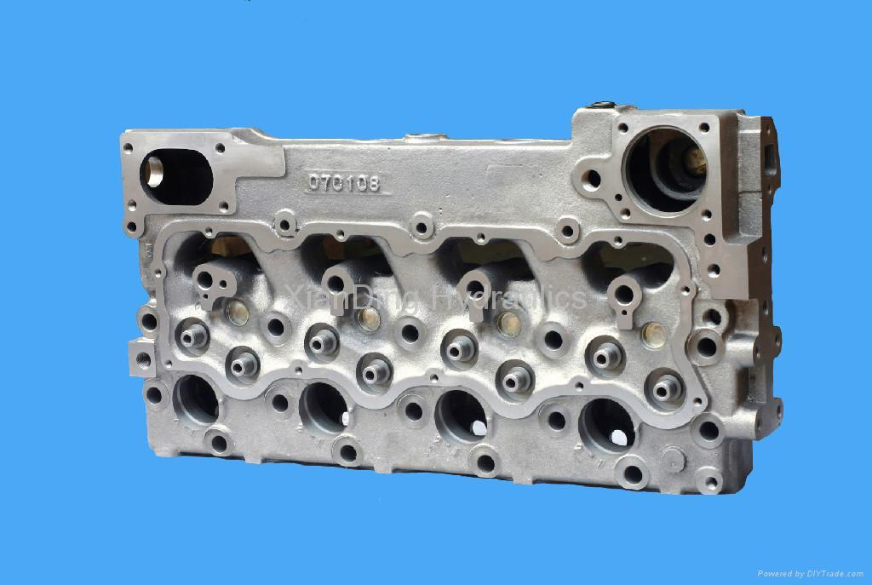

Slide 10
3. Piston & its rings
The piston is a close fitting hollow cylinderical plug reciprocating inside the cylinder.
The power developed by the combustion of the fuel is transmitted by the piston to the crank shaft through connecting rod.
The piston rings are the metallic rings inserted the circumferential grooves provided at the end of the piston. These rings maintain a gas-tight joint between the piston and the cylinder while the piston is reciprocating in the cylinder.

Slide 11
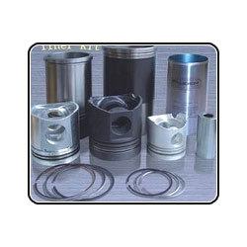

Slide 12
SPARK IGNITION FOUR STROKE ENGINE
(1) suction stroke
During this stroke , inlet valve opens and exhaust valve is closed . As this piston moves from TDC to BDC .
This creates a pressure difference between the atmosphere and inside of the cylinder . This stroke is represented by the horizontal line 1-2 on the P-V diagram.

Slide 13
(2) Compression stroke
During this stroke both inlet valve and exhaust valve are closed , the piston moves from BDC to TDC.
As this stroke is being performed , the Petrol engine and air mixture contained in the cylinder will be compressed .
The process of compression is shown in fig.
and curve 2-3.

Slide 14
(3) power or expansion stroke
During this stroke both inlet valve and exhaust valve are closed , the piston moves from TDC to BDC .
This is represented by curve 4-5 on the P-V diagram.
The drop of pressure at constant volume is represented by vertical line 5-2 on the P-V diagram.

Slide 15
(4) Exhaust stroke
During this stroke , the exhaust valve opens and the inlet valve is closed.
The piston moves from BDC to TDC and during this piston pushes the exhaust gases out of the cylinder at constant pressure.
This process is shown on P-V diagram line 2-1 in figure.

Slide 16
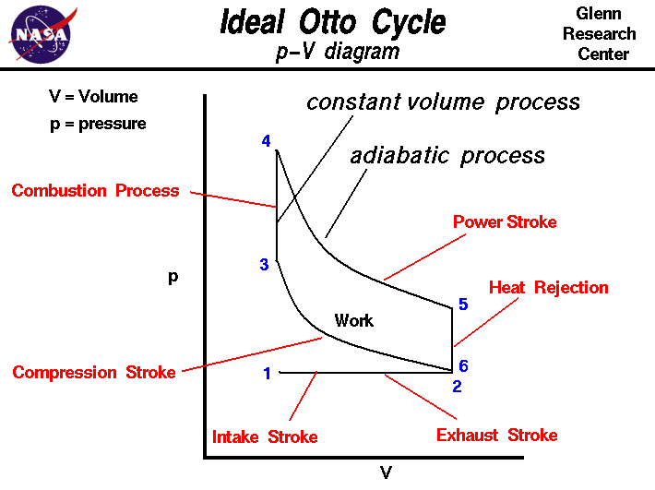

Slide 17
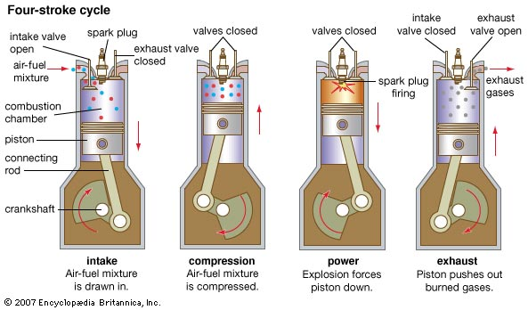

Slide 18
Difference between otto & diesel cycle
Petrol engine
Diesel engine
It works on otto cycle also called constant volume cycle.
Fuel of petrol engine is Gasoline.
Compression ratio of petrol engine’s range is 6 to 10.
It works on diesel cycle also called constant pressure cycle.
Fuel of diesel engine is Diesel.
Compression ratio of diesel engine’s range is 14 to 20.

Slide 19
In petrol engine the compressed charge is ignited by the suction stroke.
Quantity governing method is used for controlling speed.
In diesel engine diesel will ignit automatically when comes in contact with hot air.
Quality governing method is used for controlling speed.

Slide 20
6. Engine speed of petrol engine is about 3000 RPM.
7. Maintance cost of petrol engine is less.
8. Running cost of petrol engine is costlier.
6. Engine speed of diesel engine is about 500-1500 RPM.
7. Maintance cost of diesel engine is very high.
8. Running cost of diesel engine is cheaper.

Slide 21
THANK YOU

